Slide 1
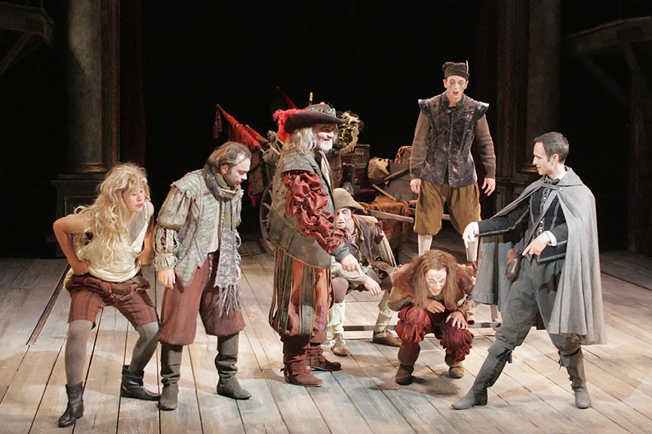
CC – 11
Modern & Contemporary Drama
Tom Stoppard
Rosencrantz and Guildenstern are Dead
Introduction
Dr. Md Naushad Alam
Assistant Professor, P. G. Dept of English
MMHAPU
Notes:
NOTE:
To change the image on this slide, select the picture and delete it. Then click the Pictures icon in the placeholder to insert your own image.

Slide 2
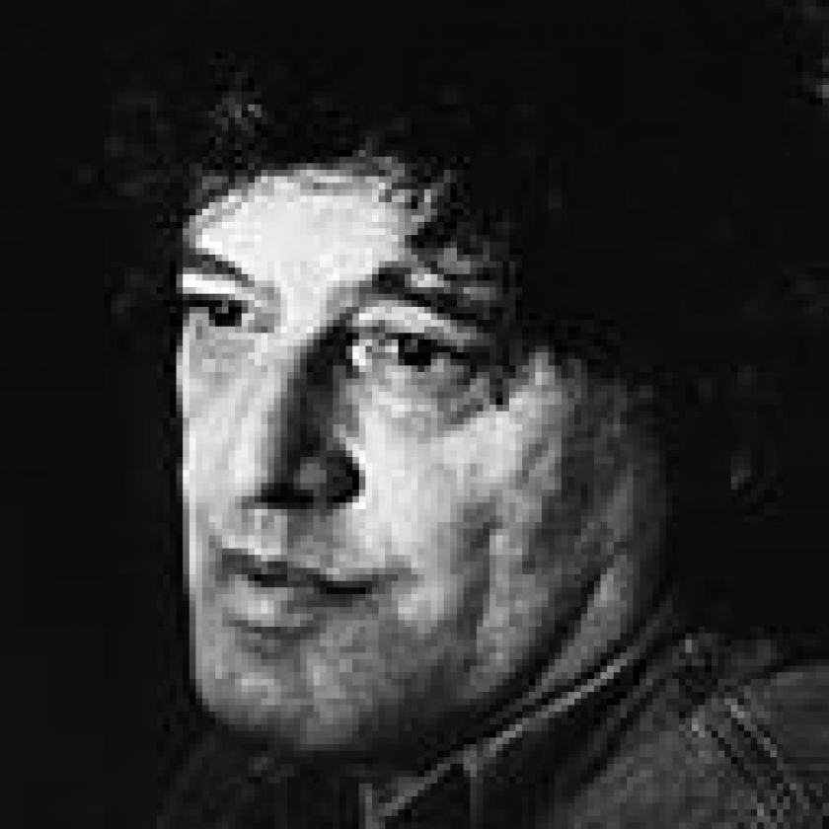
Tom Stoppard
Life & work
Playwright Sir Tom Stoppard was born Tomas Straussler on 3 July 1937 in Zlin, Czechoslovakia. He grew up in Singapore and India during the Second World War and moved to England in 1946 with his mother and stepfather, his own father having been killed in Singapore.
He is a Czech-born British playwright and screenwriter. He has written for television, radio, film, and stage, finding prominence with plays such as Arcadia, The Coast of Utopia, Every Good Boy Deserves Favour, Professiona Foul, The Real Thing, Travesties, The Invention of Love, and Rosencrantz and Guildenstern Are Dead. He co-wrote the screenplays for Brazil, The Russia House, and Shakespeare in Love, and has received an Academy Award and four Tony Awards. His work covers the themes of human rights, censorship and political freedom, often delving into the deeper philosophical understanding of society. Stoppard has been a playwright of the National Theatre and is one of the most internationally performed dramatists of his generation.

Slide 3
Rosencrantz and Guildenstern Are Dead
Historical Context
Sources
A mid-twentieth century theatre movement largely centred in Europe, the Theatre of the Absurd invented a new dramatic style designed to express belief in life's ultimate meaninglessness, absurdity, and incomprehensibility and to expose the futility of human rationality. Plays in this movement conveyed these beliefs by incorporating uncomfortable silences, parodying realism, making characters perform meaningless and repetitive actions, mixing comedy and tragedy, avoiding scenes of resolution or enlightenment, and writing dialogue whose copious wordplay and nonsense suggested the meaninglessness of language itself and its insufficiency as a means of communication. Playwrights of the Absurd included Samuel Beckett, Jean Genet, Eugene Ionesco, Harold Pinter, and Tom Stoppard.
Aside from Hamlet, Stoppard's play is also influenced by another major drama: Waiting for Godot by Samuel Beckett. First performed in 1952, Beckett's play fundamentally changed theatre by abandoning traditional ideas of character and plot and by commenting on techniques of play-acting within the play itself. Stoppard's play makes use of many of these dramatic innovations while also referencing Waiting for Godot more explicitly: like Beckett's, Stoppard's play is built around two men waiting around on stage for action that seems never to come.

Slide 4
Rosencrantz and Guildenstern Are Dead
Facts
Full Title : Rosencrantz and Guildenstern Are Dead
When Written : 1964
Written in : England
Published in : 1967
Literary Period : Theatre of the Absurd
Genre : Tragicomedy
Setting :
Climax :
Antagonist : The Player
Nowhere; the royal court in Denmark; a ship to England
Rosencrantz and Guildenstern read Claudius' letter and discover that it orders Hamlet executed.

Slide 5
Rosencrantz and Guildenstern Are Dead
Characters
Guildenstern (Guil)
Rosencrantz (Ros)
The Player
Hamlet
Claudius
Gertrude
Alfred
Ophelia
Polonius
Horatio

Slide 6
Rosencrantz and Guildenstern Are Dead
Title
The title is taken directly from the final scene of Shakespeare’s Hamlet. In earlier scenes Prince Hamlet has been exiled to England by the treacherous King of Denmark (his uncle Claudius, who has murdered Hamlet's father to obtain the throne). En route to England, Hamlet discovers a letter from King Claudius which is being carried to England by Hamlet's old but now untrusted friends Rosencrantz and Guildenstern. The letter commands that Hamlet be put to death upon his arrival in England. Hamlet rewrites the letter to command that instead, Rosencrantz and Guildenstern be put to death. He then escapes back to Denmark.
By the end of Shakespeare's play, Prince Hamlet, Laertes, Ophelia, Polonius, King Claudius, and Queen Gertrude all lie dead.
An ambassador from England arrives on the scene to bluntly report "Rosencrantz and Guildenstern are dead" (Hamlet. Act V, Scene II, line 411); they join the stabbed, poisoned and drowned key characters. By the end of Hamlet, Horatio is the only main figure left alive.
A previous, satirical play of a similar nature named Rosencrantz and Guildenstern was written by W. S. Gilbert in 1874 and performed in 1891. (*wiki)

Slide 7
Rosencrantz and Guildenstern Are Dead
Synopsis
The play concerns the musings and mishaps of Rosencrantz and Guildenstern, two minor characters from William Shakespeare’s play Hamlet, who are childhood friends of the Prince, focusing on their actions instead – with the events of Hamlet as the backdrop. Consequently, the play is structured as the inverse of Hamlet; the title characters are the leads – not supporting players – and Hamlet himself is but a minor role. The duo appears on stage here instead of off-stage, with the exception of a few short scenes in which the dramatic plays converge.
In Hamlet, Rosencrantz and Guildenstern operate under the King’s command in an attempt to discover Hamlet's motives and plot against him. Hamlet, however, derisively mocks and outwits them, so that they, rather than he, are sentenced to death in the end. From the perspective of Rosencrantz and Guildenstern their actions are largely nonsensical but this is because they are superseded and, therefore, determined by Hamlet’s plot.
**Conti…

Slide 8
Synopsis - ….conti.*
After witnessing a performance of The Murder of Gonzago – a story in the play Hamlet – they find themselves on a ship, transporting Prince Hamlet to the King in England, with the troupe that staged the performance also on board as stowaways. They are supposed to give him a letter with an instruction to execute Hamlet, who discovers this and replaces the letter with another one. During the voyage, the ship is hijacked by pirates, after which it is discovered that Hamlet has disappeared and the letter, now, instead instructs the English monarch to execute them.
The troupe recreates the duel scene from Hamlet with Rosencrantz and Guildenstern, at the end, accepting quo fata ferunt (“whither the fates carry [us]”). The play concludes with the final scene from Hamlet in which the English Ambassador arrives and announces that “Rosencrantz and Guildenstern are dead”.

Slide 9
Rosencrantz and Guildenstern are Dead
Critical Analysis
Rosencrantz and Guildenstern are Dead was Tom Stoppard's breakthrough play. It was a huge critical and commercial success, making him famous practically overnight. Though written in 1964, the play was published in 1967, and it played on Broadway in 1968, where it won the Tony for best play.
The play cleverly re-interprets Shakespeare's Hamlet from the point of view of two minor characters: Rosencrantz and Guildenstern. The Laurel-and-Hardy-like pair are totally incidental to the action of Hamlet, subject to the whims of the King Claudius – who gets them to betray Hamlet – and then tricked by Hamlet into delivering a letter that condemns them to death. Stoppard's play turns Hamlet on its head by giving these two the main roles and reducing all of Shakespeare's major characters (including Hamlet) to minor roles. Written around and in-between the lines of Shakespeare's play, Stoppard brilliantly takes the main concerns of contemporary theatre – absurdism, the inevitability of death, breakdown in communication and feeling – and inserts them into the text of a much earlier play.
**Conti…

Slide 10
Critical Analysis…conti.*
Stoppard wrote Rosencrantz and Guildenstern are Dead in this absurdist and meta-theatrical tradition. It is very much influenced by Beckett, and much of the silly dialogue between Rosencrantz and Guildenstern simply would not have been seen in the theatre before Waiting for Godot. It's as if Stoppard uses the innovations that Beckett brought to contemporary theatre in order to pry open the minor Shakespearean characters of Rosencrantz and Guildenstern.
Some critics think that Stoppard was too much under the influence of Beckett at this point in his career, but we think that Rosencrantz and Guildenstern are Dead is something unique and independent of both Waiting for Godot and Hamlet. It is an almost universally acknowledged masterpiece of contemporary theatre.
…the End.

